Slide 1
Secure Network Design and Implementation
CSCE 5585 Course Project
Chandana Mariyada
Dheeraj
raj

Slide 2
Objectives
Design, implement, and evaluate a secure network using industry tools
Ensure security of communication pathways and devices
Deploy Firewall, VPN, IDS/IPS
Include Pen-testing to assess robustness

Slide 3
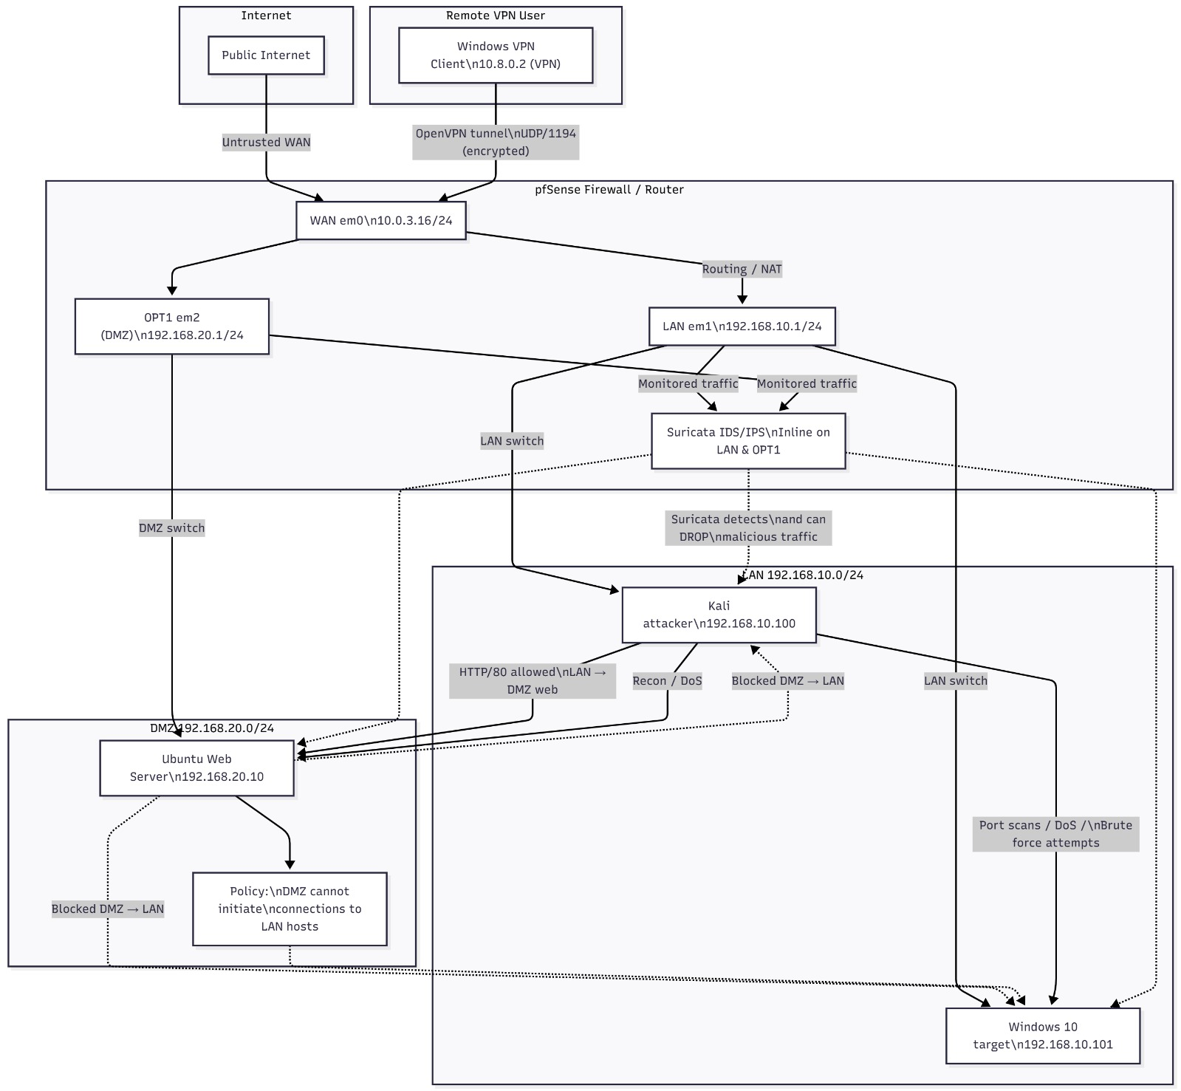

Slide 4
Technologies
Network Design
Firewall
VPN
IDS/IPS
Testing Tools: Nmap, Metasploit, Nessus, Wireshark CSCE 5585 Secure Network Design…

Slide 5
Deliverables
Network topology diagrams
Firewall, VPN, IDS/IPS configurations
Penetration testing report
Complete documentation and presentation

Slide 6
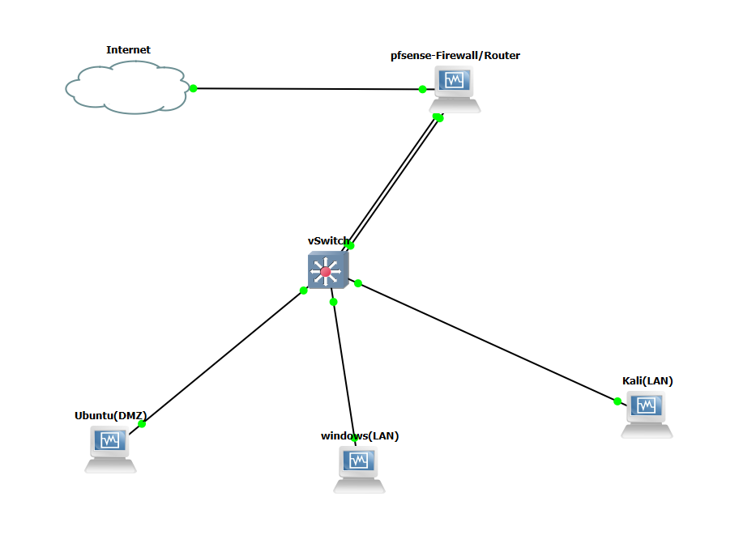
Network Environment Setup
Used virtual labs like GNS3, VirtualBox, VMware, EVE-NG
Created virtual instances of routers, switches, pfSense, and servers
VLANs + DMZ + internal servers setup

Slide 7
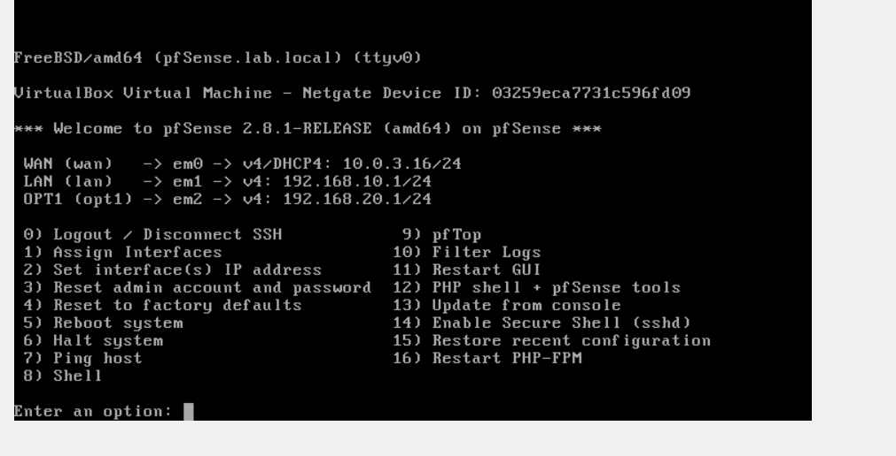
Network Architecture
Segmented Secure Network
Components:
LAN: internal clients and applications
DMZ: public-facing services
WAN: external connection / cloud provider
Outcome: Controlled traffic paths and reduced attack surface

Slide 8
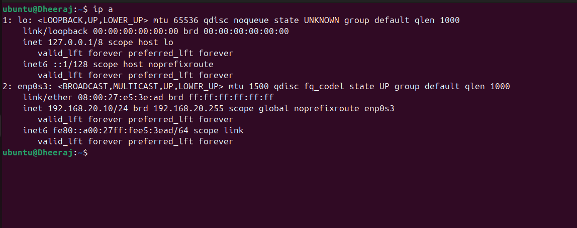
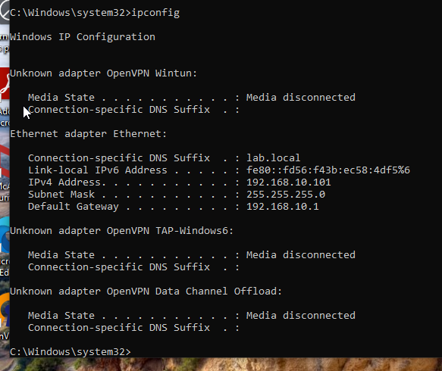
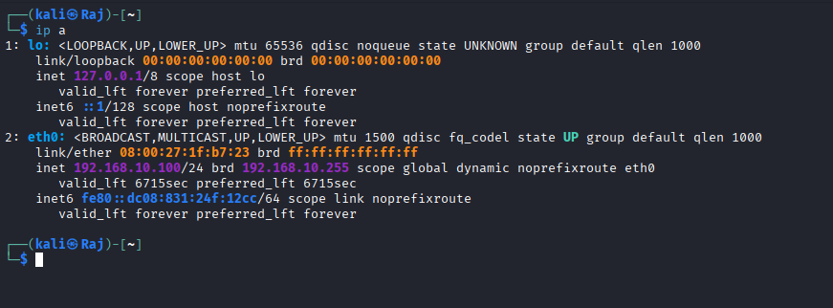
Ubuntu DMZ IP
Windows LAN
Kali LAN screenshot

Slide 9
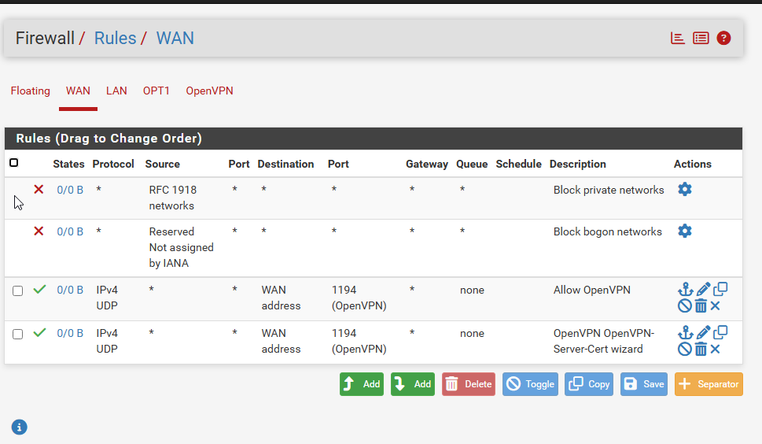
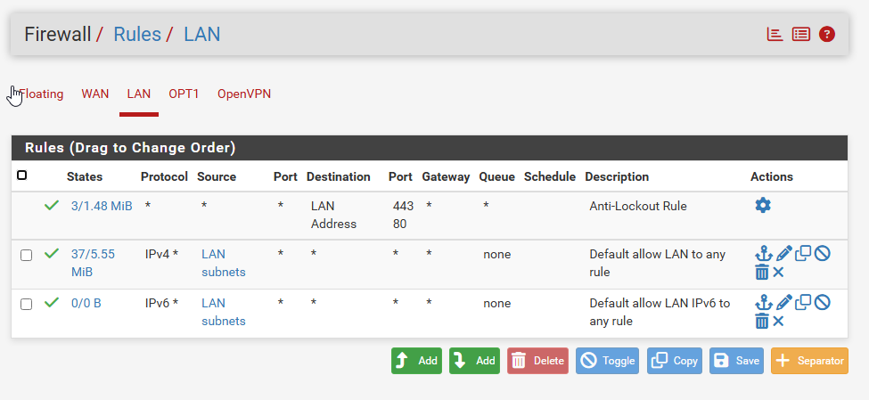
Firewall as Perimeter Defense
pfSense Enforcement Layer
Interface-based rules for WAN, LAN & DMZ
NAT configured for secure external access
ACLs restrict lateral movement
Logging enabled for packet inspection
WAN Rules
LAN Rule

Slide 10
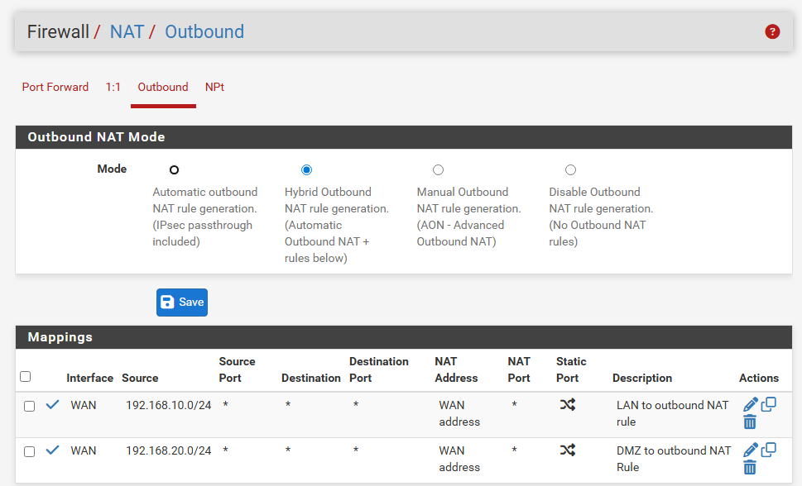
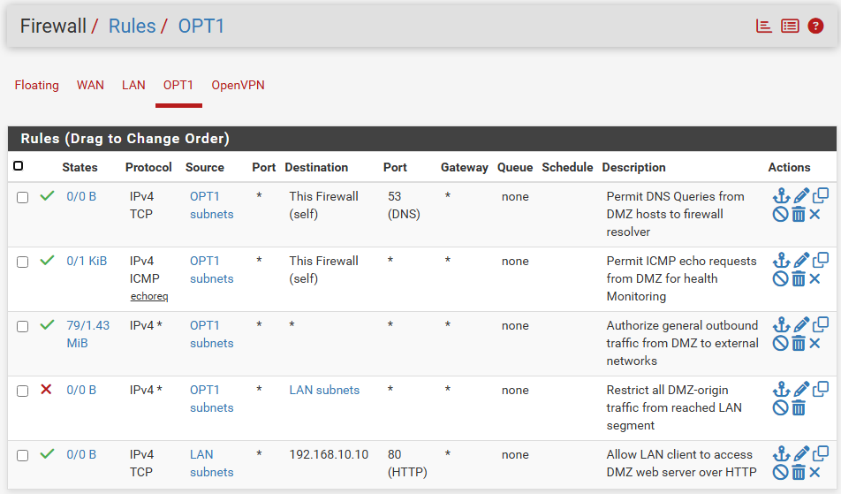
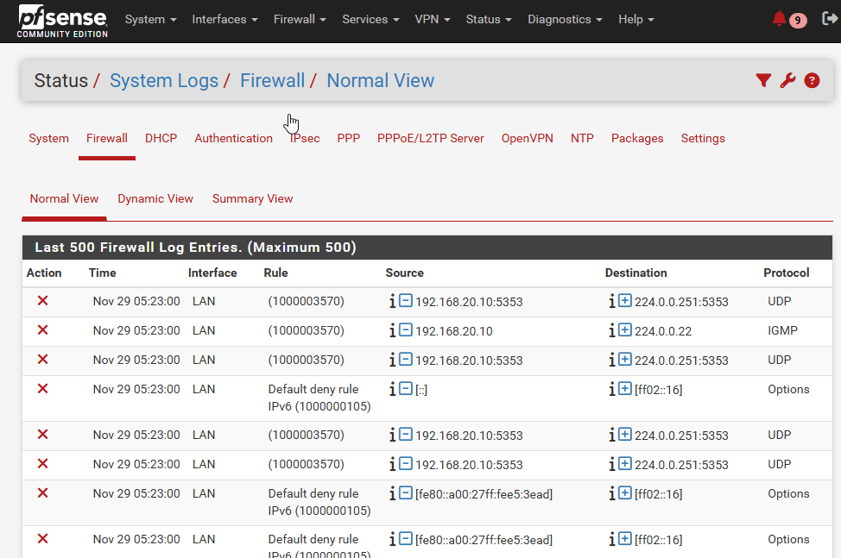
OPT(DMZ) Rule
NAT Configuration
Blocked DMZ→LAN packet screenshot

Slide 11
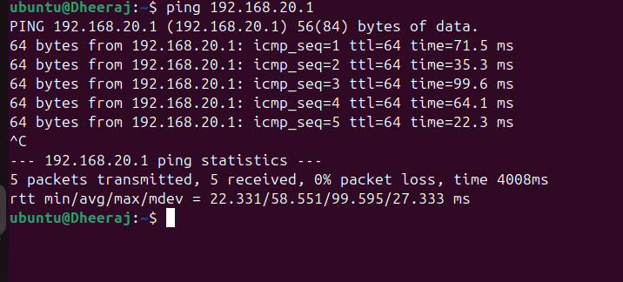
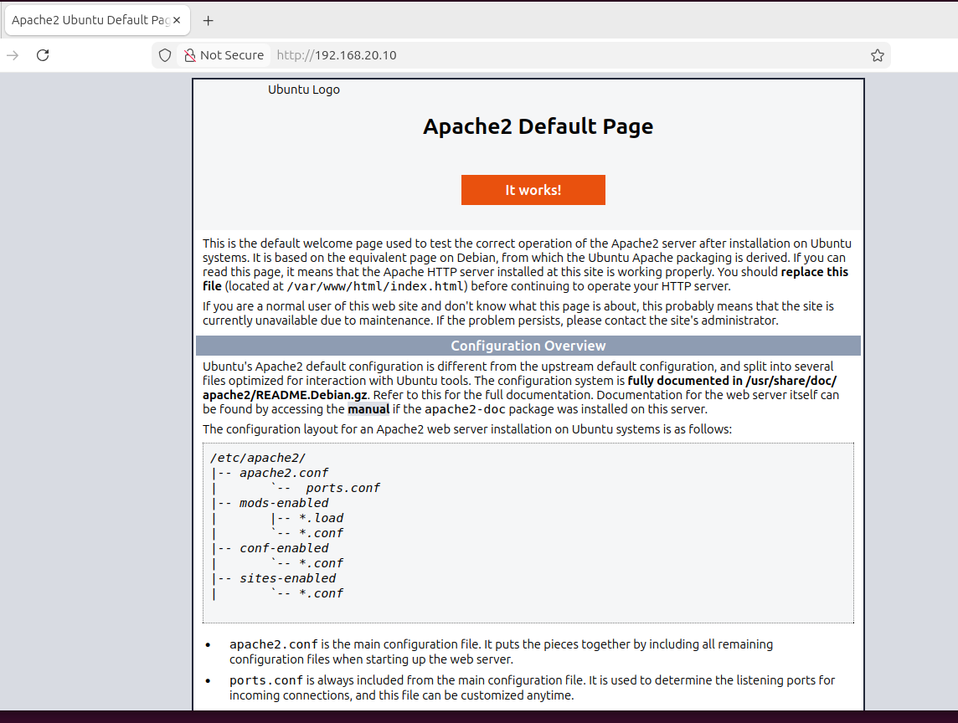
Segmentation & Access Control
Zero-Trust Segmentation Model
VLANs separate HR, Finance, Operations
DMZ hosts isolated from LAN
Explicit permissions only for business routes
No direct traffic from DMZ → LAN
Ubuntu → pfSense DMZ (192.168.20.1)

Slide 12
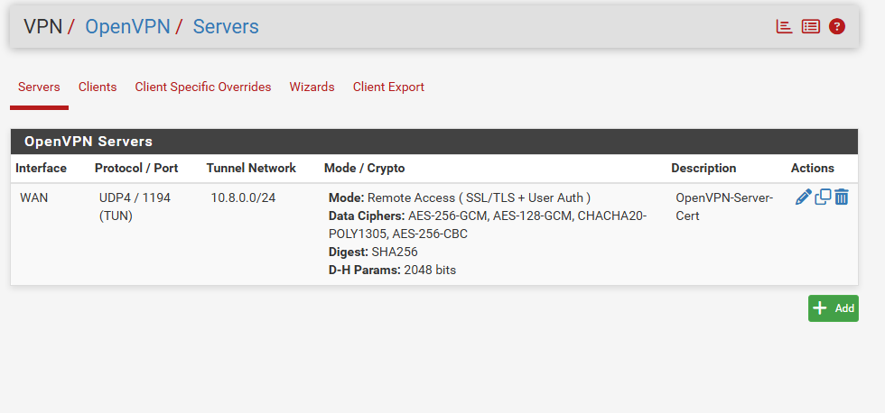
VPN Secure Remote Access
OpenVPN Integration
Encrypted remote communication
Client exported profiles for authentication
VPN traffic controlled via pfSense rules
Validated secure access to resources

Slide 13

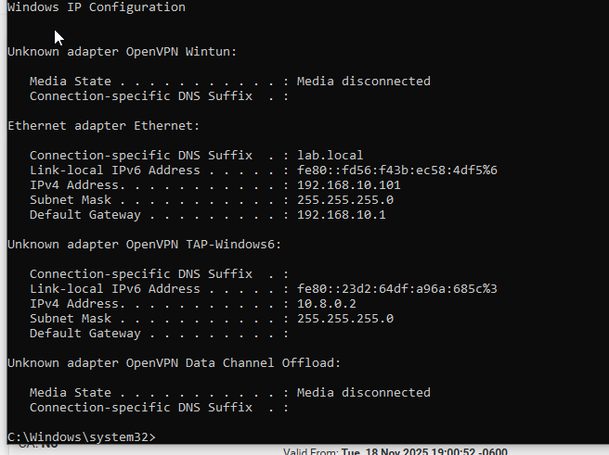
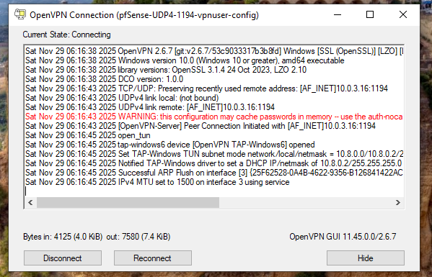
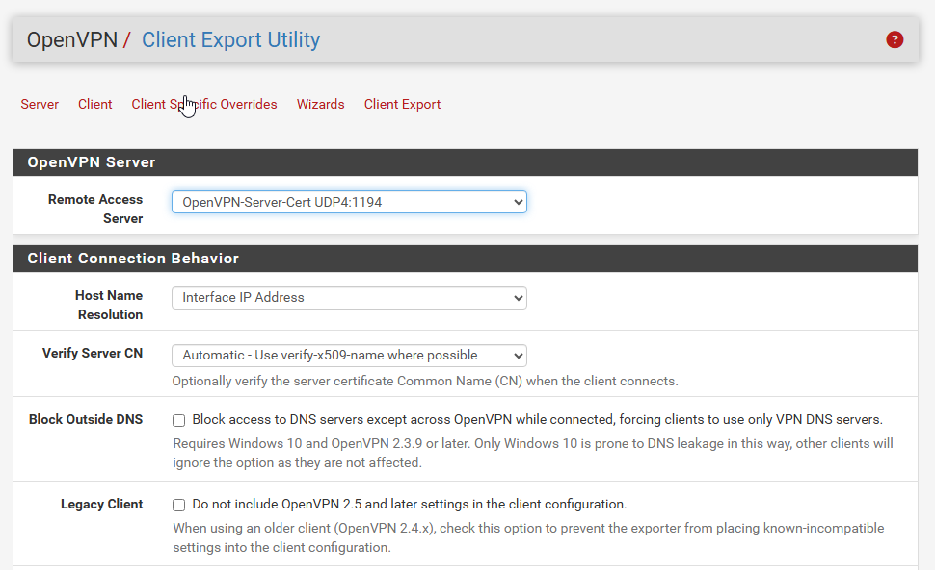
Client Connected Screenshot
Windows VPN assigned IP
OpenVPN Firewall Rule

Slide 14
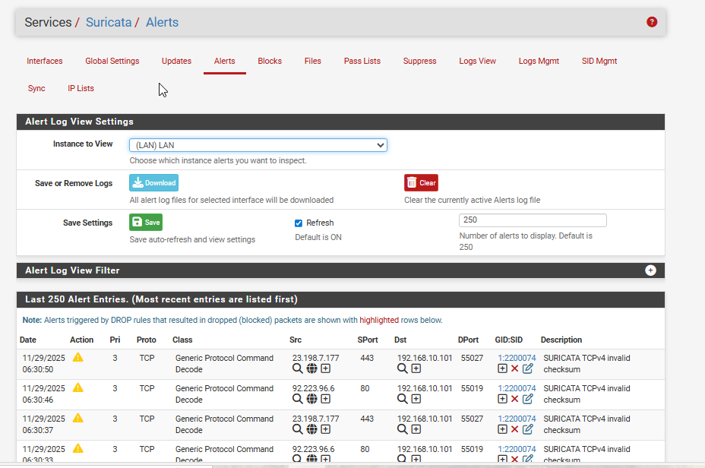
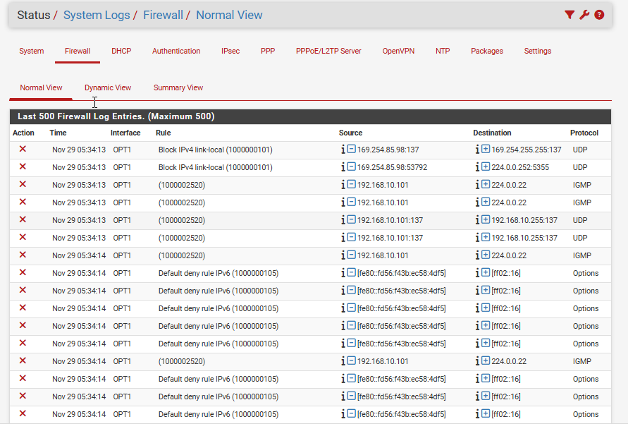
IDS/IPS Threat Detection
Suricata IDS/IPS Protection
We installed Suricata to monitor LAN and DMZ
We ran attacks (Nmap scans, brute-force, DoS simulation) from Kali
Suricata detected and blocked malicious packets in real time
Firewall and IDS logs proved our defenses worked

Slide 15
What We Achieved
We isolated critical assets using segmentation
We controlled access using firewall policies
We secured remote access via encrypted VPN
detected and blocked threats using IDS/IPS
validated the entire network using penetration testing

